Slide 1
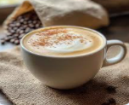
Bright Coffee Sales Project
by Innocent

Slide 2
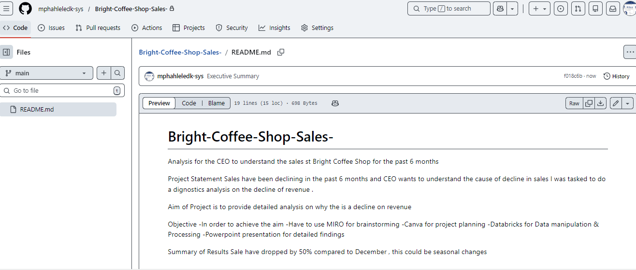
Project Details

Slide 3
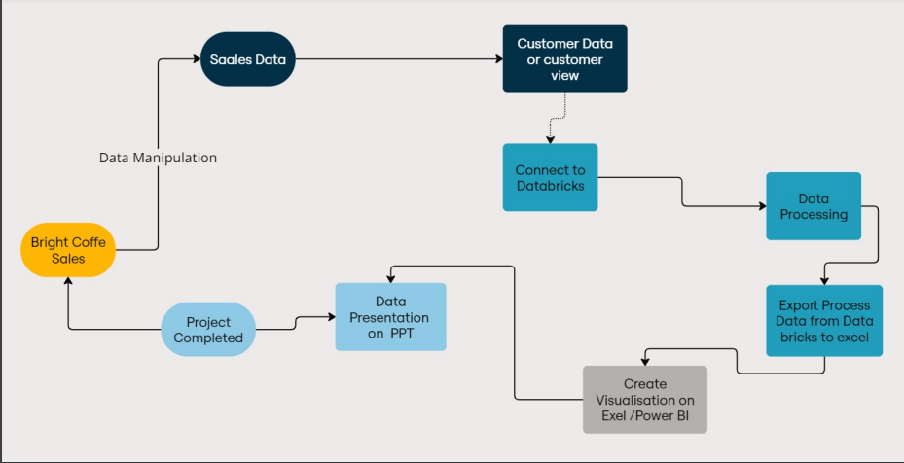
Project Process Map

Slide 4
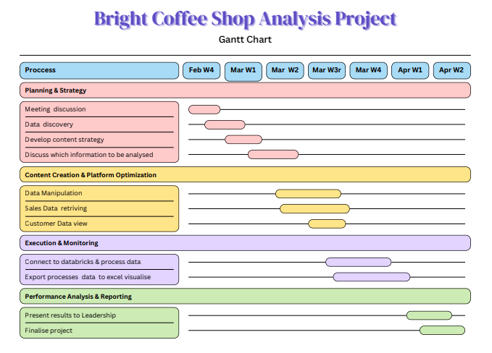
Project Master Plan

Slide 5
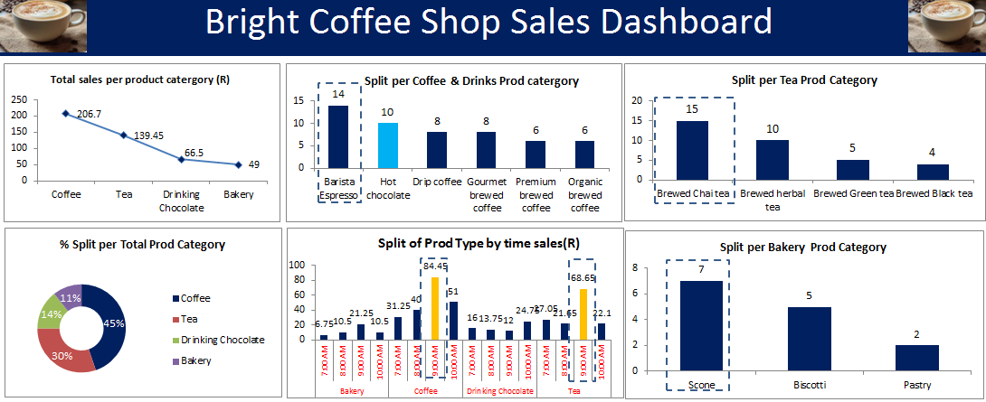
Bright Coffee Sales KPI Dashboard

Slide 6
Conclusion
More sale are generated on the coffee Product catergory at 45% on a revenue of R206.7
Highest purchases on coffer are on the barista espresso ,followed by a hot chocolate
More sales of coffee rise at 9:00 and for tea at the same time

